Slide 1
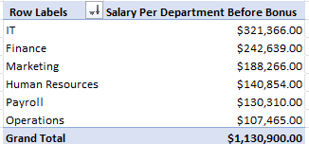
Which departments spends the most on employee salaries?

Slide 2
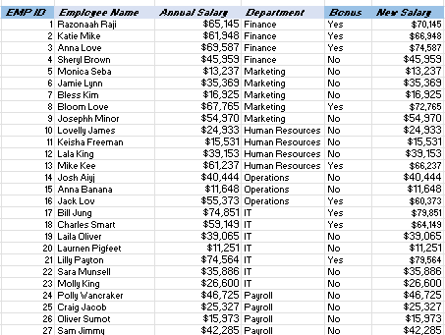
Identify employees that made over $55k and grant them a bonus of $5000
get t
Below shows how many will get the bonus

Slide 3
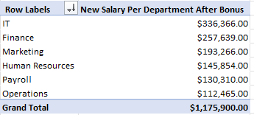
How much will be spent after adding bonus to employee salary?
After bonus total spent on salaries will go up by $45,000

